Slide 1
Mehran S. Fallah June 2020
Discrete Mathematics
Session XIII
Induction and Inductive Definitions

Slide 2


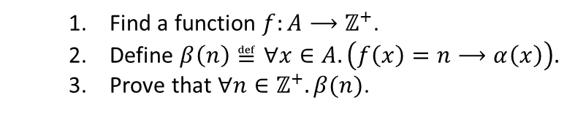
Introduction
In the previous session, we introduced the weak and strong forms of the mathematical induction, also known as induction on positive integers.
We also extended the proof principle of mathematical induction to properties of the elements of sets other than positive integers.
In general, to prove that the predicate $α$ is true of all elements of a set $A$, that is, $∀x∈A.α(x)$. One may take the following steps:
In this session, we introduce inductive definitions.
It is also explained how inductive definitions lead to the general proof principle of rule induction.
$\left(α\left(1\right)∧ ∀k∈ℤ^{+}. \left(α\left(k\right)⟶α\left(k+1\right)\right)\right) ⟹ ∀n∈ℤ^{+}. α(n)$.
$$𝒰$$
$∀k∈ℤ^{+}. \left(\left(∀m∈ℤ^{+}.\left(m<k⟶α\left(m\right)\right)\right)⟶α\left(k\right)\right)⟹∀n∈ℤ^{+}. α(n)$.
$\left(α\left(n_{0}\right)∧ ∀k∈ℤ^{≥n_{0}}. \left(α\left(k\right)⟶α\left(k+1\right)\right)\right) ⟹∀n∈ℤ^{≥n_{0}}. α(n)$.
$∀k∈ℤ^{≥n_{0}}. \left(\left(∀m∈ℤ^{≥n_{0}}.\left(m<k⟶α\left(m\right)\right)\right)⟶α\left(k\right)\right)⟹∀n∈ℤ^{≥n_{0}}. α(n)$.
Find a function $f:A⟶ℤ^{+}$.
Define $β\left(n\right)≝∀x∈A. \left(f\left(x\right)=n⟶α\left(x\right)\right).$
Prove that $∀n∈ℤ^{+}. β(n)$.

Slide 3


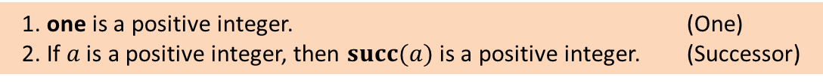
Inductive Definitions
Numbers are abstract entities. No one has ever seen a number. The following are the numerals that denote positive integers.
But, how can one define positive integers?
Consider the following rules.
Thus, one, succ(one), succ(succ(one)), succ(succ(succ(one))), and so on are positive integers.
The set of positive integers is defined to be the smallest set closed under the rules One and Successor. In fact, everything that is obtained from a finite number of applications of the rules One and Successor is a positive integer. Moreover, every positive integer is obtained from a finite number of applications of the rules One and Successor.
The rules One and Successor can also be written as follows:
1, 2, 3, ...
one, two, three, …
I, II, III, …
🍏, 🍏🍏, 🍏🍏🍏, …
1. one is a positive integer. (One)
2. If $a$ is a positive integer, then $succ(a)$ is a positive integer. (Successor)
Axiom
Proper Rule
(One)
$a$ posint
(Successor)
one posint
$succ$($a$) posint

Slide 4


Inductive Definitions (Ctd.)
A set is said to be defined inductively if it is defined as the smallest set closed under a collection of rules.
In fact, inductive definitions define a so-called judgment form representing a set. In this way, every instance of the judgment form will have a proof, that is, a finite number of applications of the rules. Here is a proof of “succ(succ(succ(succ(one)))) posint”
(One)
$a$ posint
(Successor)
one posint
$succ(a)$ posint
one posint
one posint
succ(one) posint
succ(one) posint
succ(succ(one)) posint
succ(succ(one)) posint
succ(succ(succ(one))) posint
succ(succ(succ(one))) posint
succ(succ(succ(succ(one)))) posint
succ(succ(succ(succ(one)))) posint
Forward (Bottom-Up) Derivation
Backward (Top-Down) Derivation

Slide 5
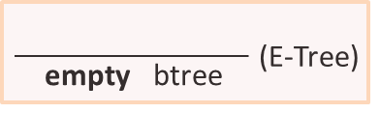
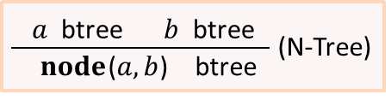
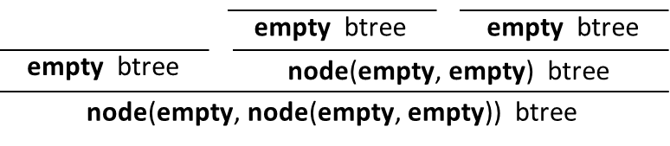

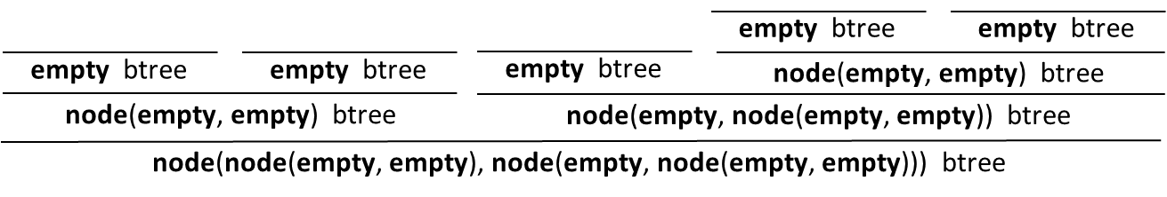
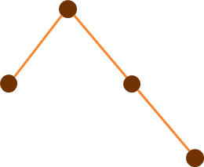
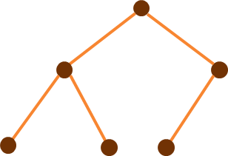
Inductive Definitions (Ctd.)
The set of binary trees can be defined inductively by the following rules.
The following are sample derivations.

Slide 6
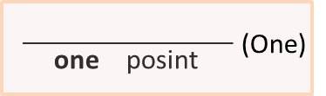
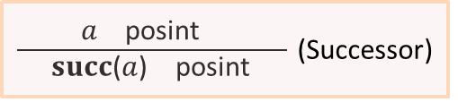
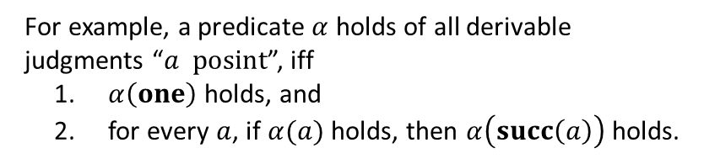
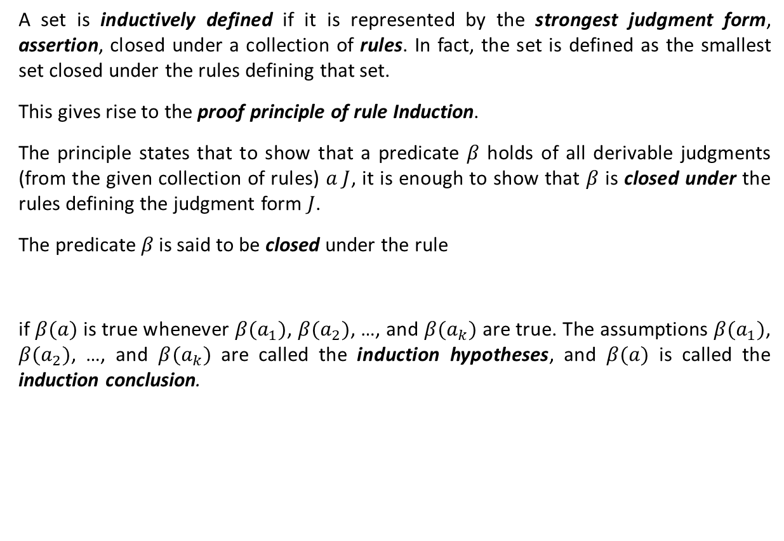


The Proof Principle of Induction
A set is inductively defined if it is represented by the strongest judgment form, assertion, closed under a collection of rules. In fact, the set is defined as the smallest set closed under the rules defining that set.
This gives rise to the proof principle of rule Induction.
The principle states that to show that a predicate $β$ holds of all derivable judgments (from the given collection of rules) $a J$, it is enough to show that $β$ is closed under the rules defining the judgment form $J$.
The predicate $β$ is said to be closed under the rule
if $β(a)$ is true whenever $β(a_{1})$, $β(a_{2})$, …, and $β(a_{k})$ are true. The assumptions $β(a_{1})$, $β(a_{2})$, …, and $β(a_{k})$ are called the induction hypotheses, and $β(a)$ is called the induction conclusion.
$$a_{1} J a_{2} J ⋯ a_{k} J$$
$$a J$$
For example, a predicate $α$ holds of all derivable
judgments “$a posint$”, iff
$α\left(one\right)$ holds, and
for every $a$, if $α(a)$ holds, then $α\left(succ\left(a\right)\right)$ holds.

Slide 7
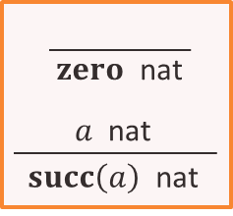
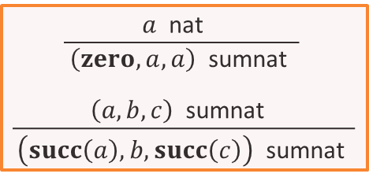
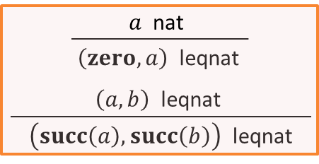
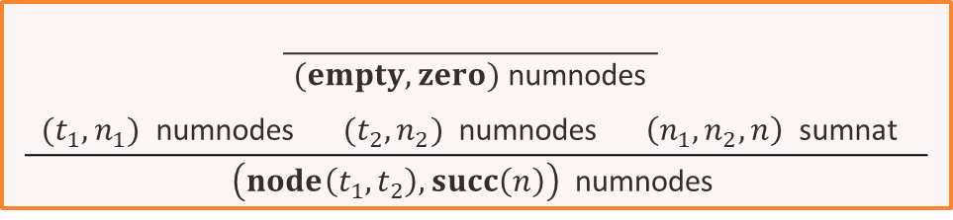
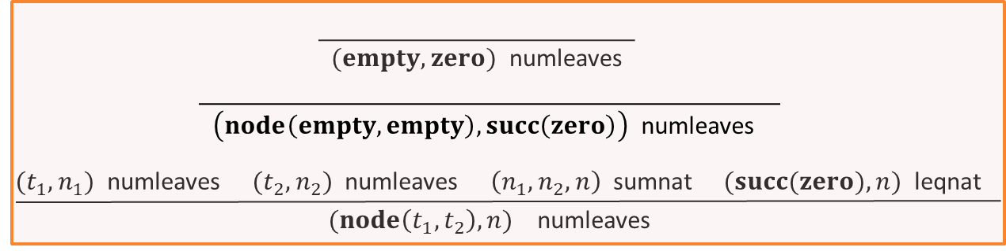
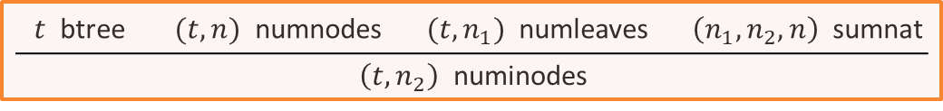

The Proof Principle of Induction (Ctd.)
We define the judgment forms “$a$ nat”, “$\left(a,b,c\right)$ sumnat”, “$\left(a,b\right)$ leqnat”, “$\left(t,n\right)$ numnodes”, “$\left(t,n\right)$ numleaves”, and “$\left(t,n\right)$ numinodes” as follows (iterative definitions):

Slide 8
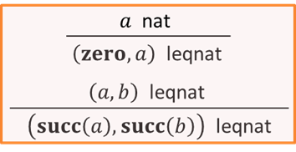
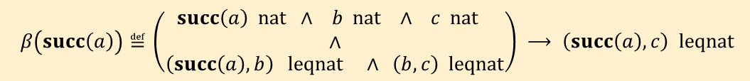








The Proof Principle of Induction (Ctd.)
Example 1. Prove that for all judgments “$a$ nat”, “$b$ nat”, and “$c$ nat”,
if “$(a,b)$ leqnat” and “$(b,c)$ leqnat”, then “$(a,c)$ leqnat”.
Solution. We use induction on “$a$ nat”. That is we show that the predicate $β$ defined below is true for all derivable judgments “$a$ nat” (universal quantification on all other judgments is implicit, for the sake of simplicity.)
Thus, we must show that $β$ is closed under the rules defining the judgment form “$a$ nat”. For the axiom $\frac{}{zero nat},$ we must show that $β(zero)$ holds. That is, the following is true.
$$\left(zero nat ∧ b nat ∧ c nat\right)⟶\left(\left(\left(zero,b\right) leqnat∧ \left(b,c\right) leqnat\right)⟶\left(zero,c\right) leqnat\right).$$
This is immediate because “$\left(zero, c\right) leqnat$” is true (derivable) whenever “$c nat$” is true (derivable). To show that $β$ is closed under the rule $\frac{a nat}{succ(a) nat},$ we must show that $β\left(succ\left(a\right)\right)$ is true if $β(a)$ is true.
$$β\left(a\right)≝\left(a nat ∧ b nat ∧ c nat ∧ \left(a,b\right) leqnat ∧ \left(b,c\right) leqnat\right)⟶\left(a,c\right) leqnat.$$
$$β\left(a\right)≝\left(a nat ∧ b nat ∧ c nat\right)⟶\left(\left(\left(a,b\right) leqnat ∧ \left(b,c\right) leqnat\right)⟶\left(a,c\right) leqnat\right).$$
$$β\left(succ\left(a\right)\right)≝\left(\begin{matrix}\begin{aligned}succ\left(a\right) nat ∧ b nat ∧ c nat \\ ∧\end{aligned} \\ \left(succ\left(a\right),b\right) leqnat ∧ \left(b,c\right) leqnat\end{matrix}\right) ⟶ \left(succ\left(a\right),c\right) leqnat$$
$$a nat$$
$$b=succ\left(b^{′}\right)$$
$$c=succ\left(c^{′}\right)$$
$$β\left(a\right)$$
$$b^{′} nat$$
$$c^{′} nat$$
$$\left(a nat ∧ b′ nat ∧ c′ nat ∧ \left(a,b′\right) leqnat ∧ \left(b′,c′\right) leqnat\right)$$
$$⟶\left(a,c′\right) leqnat.$$

Slide 9
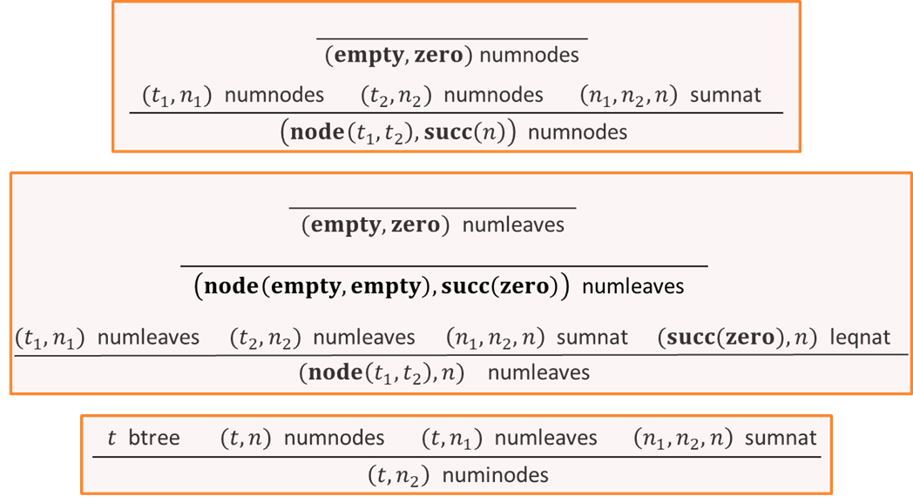





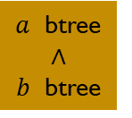






The Proof Principle of Induction (Ctd.)
Example 2. Prove that if “$t$ btree”, “$(t,m)$ numleaves”, and “$(t,n)$ numinodes”, then “$\left(m, succ\left(n\right)\right)$ leqnat.”
Solution. We use induction on the judgment form “$t$ btree.” That is, we show that the predicate $β$ defined below holds of all derivable judgments “$t$ btree.”
We must show that $β$ is closed under the rules E-Tree and N-Tree. For E-Tree, we must directly prove that $β(empty)$ is true. That is, the following formula is true.
For N-Tree, we must prove that $β\left(a\right)∧β(b)⟶β\left(node\left(a,b\right)\right)$ is true. $β\left(node\left(a,b\right)\right)$ is
$$β\left(t\right)≝ t btree ⟶\left(\left(\left(t,m\right) numleaves ∧ \left(t,n\right) numinodes\right)⟶\left(m,succ\left(n\right)\right) leqnat\right)$$
$$zero$$
$$zero$$
$$zero$$
$$empty btree$$
$⟶\left(\left(\left(empty,m\right) numleaves ∧ \left(empty,n\right) numinodes\right)⟶\left(m,succ\left(n\right)\right) leqnat\right)$.
$$n_{1}=r_{1}−m_{1}$$
$$n_{2}=r_{2}−m_{2}$$
$n$ $=r−m$
$$r=r_{1}+r_{2}+1$$
$$node\left(a,b\right) btree$$
$$⟶\left(\left(\left(node\left(a,b\right),m\right) numleaves ∧ \left(node\left(a,b\right),n\right) numinodes\right)⟶\left(m,succ\left(n\right)\right) leqnat\right)$$
$a$ btree
$∧$
$b$ btree
$$β\left(a\right)$$
$$\left(\left(\left(a,m_{1}\right) numleaves ∧ \left(a,n_{1}\right) numinodes\right)⟶\left(m_{1},succ\left(n_{1}\right)\right) leqnat\right)$$
$$β\left(b\right)$$
$$\left(\left(\left(b,m_{2}\right) numleaves ∧ \left(b,n_{2}\right) numinodes\right)⟶\left(m_{2},succ\left(n_{2}\right)\right) leqnat\right)$$
or
$m_{1}$ and $m_{2}$ are $zero$
and $m$ is $succ(zero)$
$$m_{1}≤n_{1}+1$$
$$m_{2}≤n_{2}+1$$
$$m=m_{1}+m_{2}$$

Slide 10
Textbook: Ralph P. Grimaldi, Discrete and Combinatorial Mathematics
Do exercises of Chapter 4 as homework and upload your solutions via Moodle (follow the instructions on the page of the TA of this course.)

